Slide 1
Touch
Your Ears

Slide 2
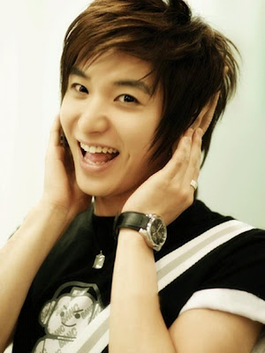
Touch, touch, touch your ears,
Touch your ears together.

Slide 3
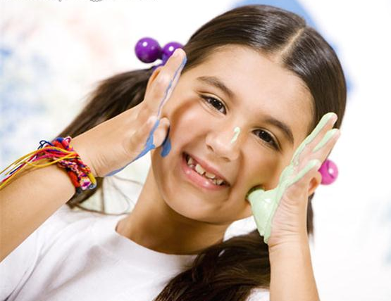
Touch, touch, touch your cheeks,
Touch your cheeks together.

Slide 4
Let`s sing
one more time !

Slide 5
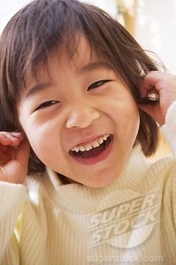
Touch, touch, touch your ears,
Touch your ears together.

Slide 6
Touch, touch, touch your cheeks,
Touch your cheeks together.

Slide 7
Использованные ресурсы:
Шаблон презентации:
http://www.free-power-point-templates.com/color-lights-powerpoint-template/
Картинки:
http://3.bp.blogspot.com/-7Atf5PTDJZQ/UAt0ZxUOZkI/AAAAAAAAEE0/rMu6jguW4js/s400/Leeteuk+Touch+his+ears.jpg
- a boy touches ears
http://wwwdelivery.superstock.com/WI/223/1802/PreviewComp/SuperStock_1802R-23320.jpg
- a girl touches ears
http://www.visualphotos.com/photo/2x3416262/portrait_of_a_girl_with_paint_on_her_palms_and_gws170054.jpg - a girl touches cheeks
http://www.nashvilleparent.com/wp-content/uploads/2010/10/boy.jpg - a boy touches cheeks
М.З.Биболетова и др. Английский язык с удовольствием. Учебник для 2 класса. – Обнинск: Титул, 2012.

